Slide 1
Module 1
Fundamentals of Wireless Communication
Introduction to Wireless Communication - Advantages, Disadvantages and Applications; Multiple Access Techniques - FDMA, TDMA, CDMA, OFDMA; Spread Spectrum Techniques – DSSS, FHSS; Evolution of wireless generations – 1G to 5G (Based on technological differences and advancements); 5G – Key requirements and drivers of 5G systems, Use cases, Massive MIMO.
Self-learning Topics: Modulation Techniques - QAM, MSK, GMSK

Slide 2
Introduction to Wireless Communication
Wireless communication involves the transmission of information over a distance without the help of wires, cables or any other forms of electrical conductors.
Wireless communication is a broad term that incorporates all procedures and forms of connecting and communicating between two or more devices using a wireless signal through wireless communication technologies and devices.

Slide 3
Features of Wireless Communication
The transmitted distance can be anywhere between a few meters (for example, a television's remote control) and thousands of kilometers (for example, radio communication).
Wireless communication can be used for cellular telephony, wireless access to the internet, wireless home networking, and so on.
Other examples of applications of radio wireless technology include GPS units, garage door openers, wireless computer mice, keyboards and headsets, headphones, radio receivers, satellite television, broadcast television and cordless telephones.

Slide 4
Two devices (transmitter and receiver) must use same frequency (or channel) to be able to communicate with each other.
If a large number of wireless devices communicate at same time, radio frequency can cause interference with each other.
Interference increases as no of devices increases.
For effective use of media, all wireless devices operate in half duplex mode to avoid collision or interference.

Slide 5
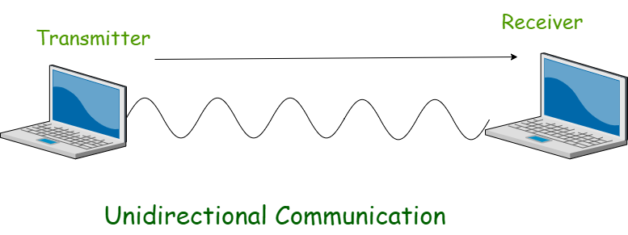
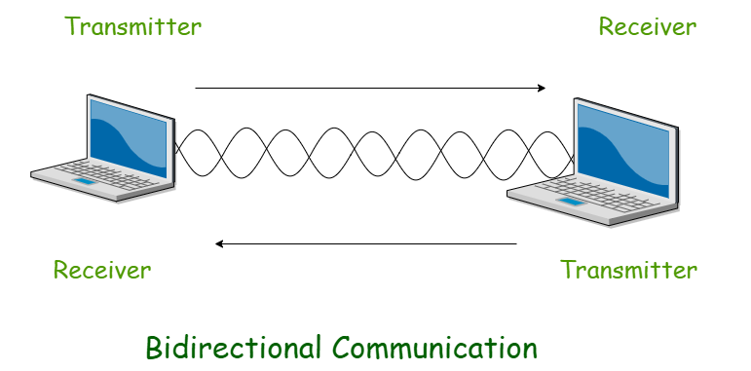
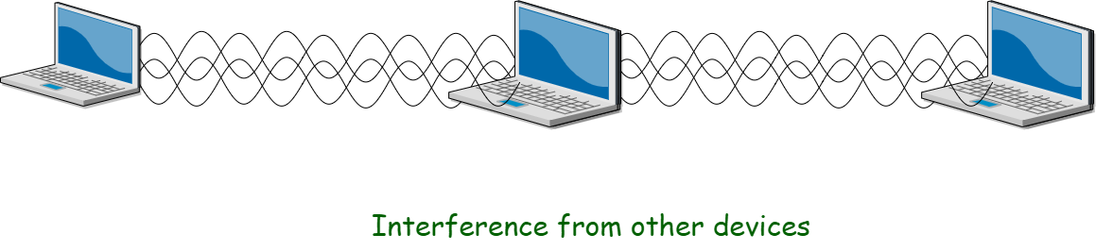

Slide 6
Note – Wireless communication is always half duplex as transmission uses same frequency or channel.
To achieve full duplex mode, devices use different frequency or channel of transmission and receiving of signals.
You can say that wireless communication is Full duplex but technically it is not.

Slide 7
What is Electromagnetic Wave?
Electromagnetic Waves carry the electromagnetic energy of electromagnetic field through space. Electromagnetic Waves include Gamma Rays (γ – Rays), X – Rays, Ultraviolet Rays, Visible Light, Infrared Rays, Microwave Rays and Radio Waves. Electromagnetic Waves (usually Radio Waves) are used in wireless communication to carry the signals.
An Electromagnetic Wave consists of both electric and magnetic fields in the form of time varying sinusoidal waves. Both these fields are oscillating perpendicular to each other and the direction of propagation of the Electromagnetic Wave is again perpendicular to both these fields.
Mathematically, an Electromagnetic Wave can be described using Maxwell’s equations. Pictorial representation of an Electromagnetic Wave is shown below, where the Electric Field is acting in the Y – axis, magnetic field is acting in the Z – axis and the Electromagnetic Wave propagates in X – axis.

Slide 8
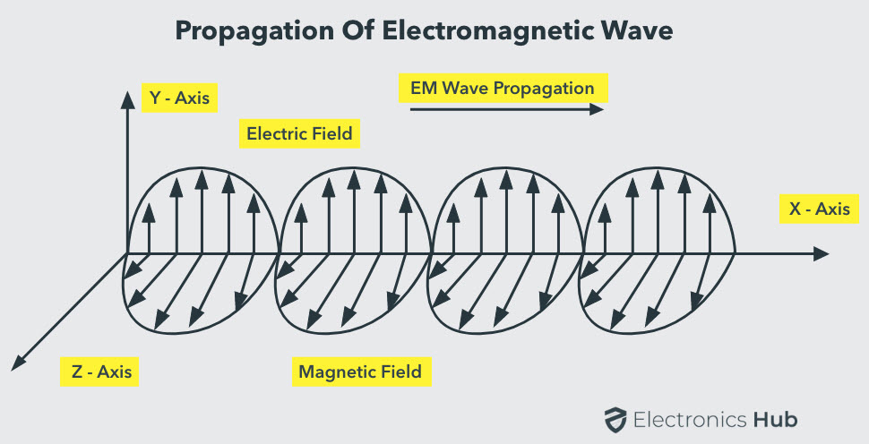

Slide 9
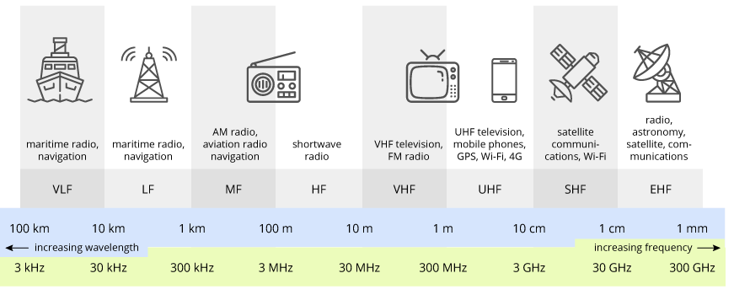
Radio Frequency:
Radio frequency was best used in the 90’s and it is useful to calculate the rate of change of the oscillation of the electromagnetic spectrum.
RF is a wireless means of communication and broadcasting. With an upper limit and lower limit being 300 GHz and 9 kHz, RF uses transmitters and receivers of various types to calculate and process.

Slide 10
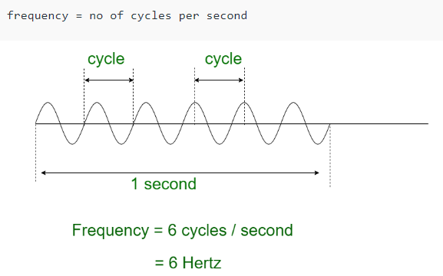
Unit of Measurement and Radiation:
The radio frequency is measured in Hertz (Hz [Unit of measurement]) and it informs us about the number of wave cycles transmitted in one second.
RF waves are invisible to the human eye. It has a particular spectrum. For increased frequency more than the intended limit of the spectrum, the electromagnetic spectrum might alter its form.
Thus, if the frequency of the RF spectrum goes beyond its upper limit, the electromagnetic rays emerge in the form of Infrared radiation, Gamma rays, X-Rays, and UV Rays most of which are visible to human eyes.

Slide 11
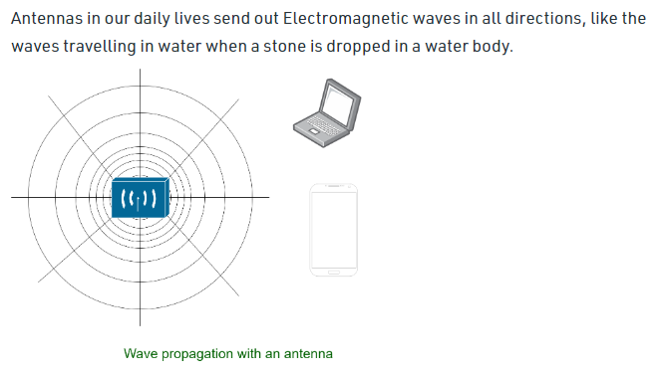
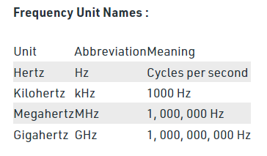
Antennas are electrical devices that transform the electrical signals to radio signals in the form of Electromagnetic (EM) Waves and vice versa. These Electromagnetic Waves propagates through space. Hence, both transmitter and receiver consists of an antenna.

Slide 12
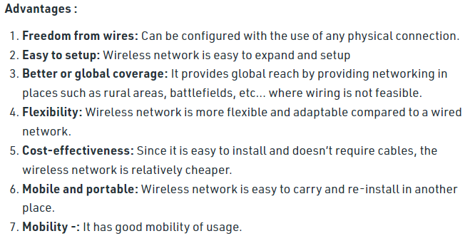
Advantages and disadvantages of Wireless Communication

Slide 13
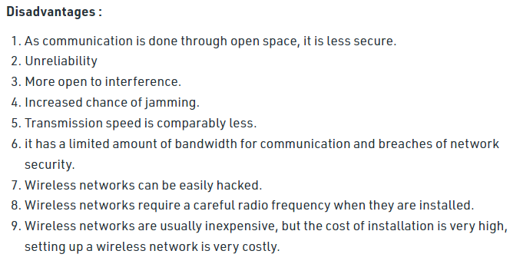

Slide 14
Interference
Wireless Communication systems use open space as the medium for transmitting signals. As a result, there is a huge chance that radio signals from one wireless communication system or network might interfere with other signals.
The best example is Bluetooth and Wi-Fi (WLAN). Both these technologies use the 2.4GHz frequency for communication and when both of these devices are active at the same time, there is a chance of interference.
Security
One of the main concerns of wireless communication is Security of the data. Since the signals are transmitted in open space, it is possible that an intruder can intercept the signals and copy sensitive information.
Health Concerns
Continuous exposure to any type of radiation can be hazardous. Even though the levels of RF energy that can cause the damage are not accurately established, it is advised to avoid RF radiation to the maximum.

Slide 15
Applications of Wireless Communication :
Satellite system
Television remote control
Wi-Fi
Paging system
Wi-Max
Security systems
Cellphones
Computer interface devices
Bluetooth
GPS
GSM

Slide 16
Television and Radio Broadcasting
Radio is considered to be the first wireless service to be broadcast. It is an example of a Simplex Communication System where the information is transmitted only in one direction and all the users receiving the same data.
Satellite Communication
Satellite Communication System is an important type of Wireless Communication. Satellite Communication Networks provide worldwide coverage independent to population density.
Satellite Communication Systems offer telecommunication (Satellite Phones), positioning and navigation (GPS), broadcasting, internet, etc. Other wireless services like mobile, television broadcasting and other radio systems are dependent of Satellite Communication Systems.
Mobile Telephone Communication System
Perhaps, the most commonly used wireless communication system is the Mobile Phone Technology. The development of mobile cellular device changed the World like no other technology. Today’s mobile phones are not limited to just making calls but are integrated with numerous other features like Bluetooth, Wi-Fi, GPS, and FM Radio.

Slide 17
The latest generation of Mobile Communication Technology is 5G (which is indeed successor to the widely adapted 4G). Apart from increased data transfer rates (technologists claim data rates in the order of Gbps), 5G Networks are also aimed at Internet of Things (IoT) related applications and future automobiles.
Global Positioning System (GPS)
GPS is solely a subcategory of satellite communication. GPS provides different wireless services like navigation, positioning, location, speed etc. with the help of dedicated GPS receivers and satellites.
Bluetooth
Bluetooth is another important low range wireless communication system. It provides data, voice and audio transmission with a transmission range of 10 meters. Almost all mobile phones, tablets and laptops are equipped with Bluetooth devices. They can be connected to wireless Bluetooth receivers, audio equipment, cameras etc.
Paging
Although it is considered an obsolete technology, paging was a major success before the wide spread use of mobile phones. Paging provides information in the form of messages and it is a simplex system i.e. the user can only receive the messages.

Slide 18
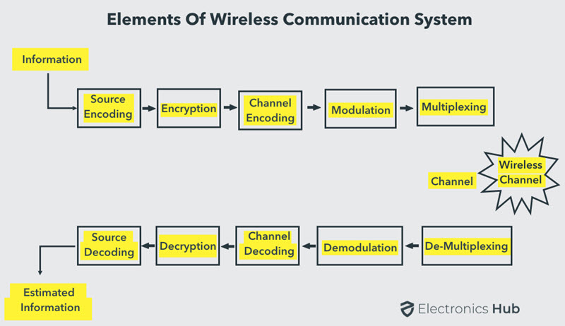
Basic Elements of a Wireless Communication System

Slide 19
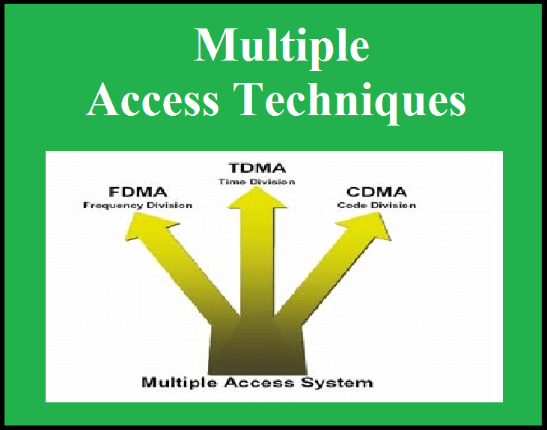
Multiple Access Techniques

Slide 20
Multiple access Techniques (MAT)
MATs are used to allow many mobile users to share a finite amount of radio spectrum simultaneously.
Duplexer- A device with duplex channel (two simplex channels- a forward and a reverse)
Duplexing may be done using frequency (FDD) or time domain techniques (TDD).
#See the video https://youtu.be/1DwogdEdm_M-

Slide 21
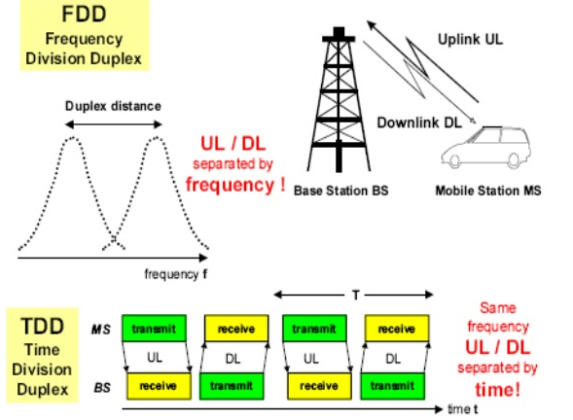
FDD Vs TDD
FDD requires two separate wireless communications channels on separate frequencies, one for transmit and the other for received data.
TDD uses a single frequency band for both transmit and receive

Slide 22
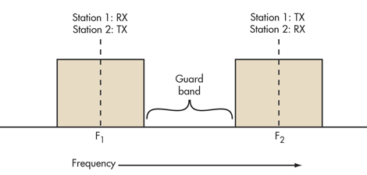
FDD
Wireless systems need two separate frequency bands or channels.
A sufficient amount of guard band separates the two bands so the transmitter and receiver don’t interfere with one another.
Good filtering or duplexers and possibly shielding are a must to ensure the transmitter does not desensitize the adjacent receiver.

Slide 23
FDD disadvantages
FDD uses lots of frequency spectrum, though, generally at least twice the spectrum needed by TDD.
Guard bands--aren’t useable, so they’re wasteful
the difficulty of using special antenna techniques like multiple-input multiple-output (MIMO) and beamforming.
It is difficult to make antenna bandwidths broad enough to cover both sets of spectrum.
More complex dynamic tuning circuitry is required.
Applications:
FDD is very widely used in cellular telephone systems, such as the widely used GSM system.
In some systems the 25-MHz band from 869 to 894 MHz is used as the downlink (DL) spectrum from the cell site tower to the handset, and the 25-MHz band from 824 to 849 MHz is used as the uplink (UL) spectrum from the handset to cell site.

Slide 24
TDD
TDD uses a single frequency band for both transmit and receive.
Then it shares that band by assigning alternating time slots to transmit and receive operations.
The information to be transmitted—whether it’s voice, video, or computer data—is in serial binary format.
Each time slot may be 1 byte long or could be a frame of multiple bytes.

Slide 25
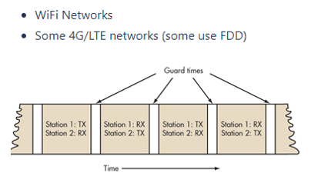
TDD alternates the transmission and reception of station data over time.
Time slots may be variable in length.
In some TDD systems, the alternating time slots are of the same duration or have equal DL and UL times.
However, the system doesn’t have to be 50/50 symmetrical. The system can be asymmetrical as required.

Slide 26
The real advantage of TDD is that it only needs a single channel of frequency spectrum.
Furthermore, no spectrum-wasteful guard bands or channel separations are needed.
The downside is that successful implementation of TDD needs a very precise timing and synchronization system at both the transmitter and receiver to make sure time slots don’t overlap or otherwise interfere with one another.
Timing is often synched to precise GPS-derived atomic clock standards.
Guard times are also needed between time slots to prevent overlap.
This time is generally equal to the send-receive turnaround time (transmit-receive switching time) and any transmission delays (latency) over the communications path.

Slide 27
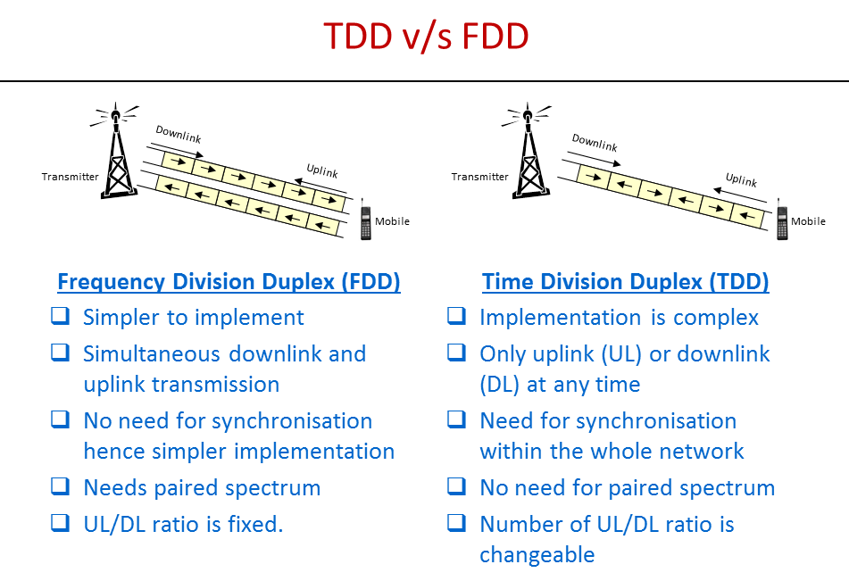

Slide 28

SELF Reflection
1.Does our Mobile phone need a duplexer? Give reasons for your answer
2.Name 2 Technologies each using FDD and TDD.
3.Is TDD going to be used in 5G?Discuss.
Write these answers in your CA activity.

Slide 29
Multiple Access Techniques
Need:
In wireless communication systems, it is often desirable to allow the subscriber to send information simultaneously from the mobile station to the base station while receiving information from the base station to the mobile station.
A cellular system divides any given area into cells where a mobile unit in each cell communicates with a base station.
The main aim in the cellular system design is to be able to increase the capacity of the channel, i.e., to handle as many calls as possible in a given bandwidth with a sufficient level of quality of service.

Slide 30
There are several different ways to allow access to the channel. These includes mainly the following −
Frequency division multiple access (FDMA)
Time division multiple access (TDMA)
Spread spectrum multiple access (SSMA) :
e.g. Code division multiple access (CDMA)
Space division multiple access (SDMA)
Depending on how the available bandwidth is allocated to the users, these techniques can be classified as
Wideband system
Narrowband system

Slide 31
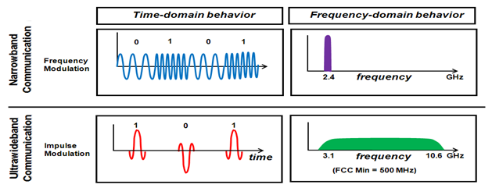
Narrowband & wideband System
Systems operating with channels substantially narrower than the coherence bandwidth are called as Narrow band systems
In wideband systems, the transmission bandwidth of a single channel is much larger than the coherence bandwidth of the channel.

Slide 32
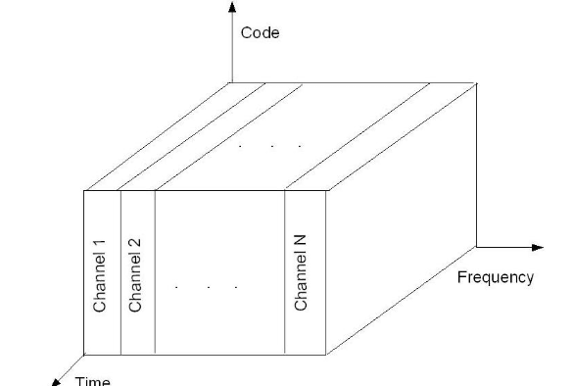
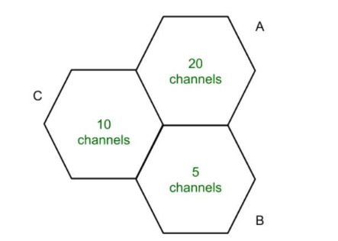
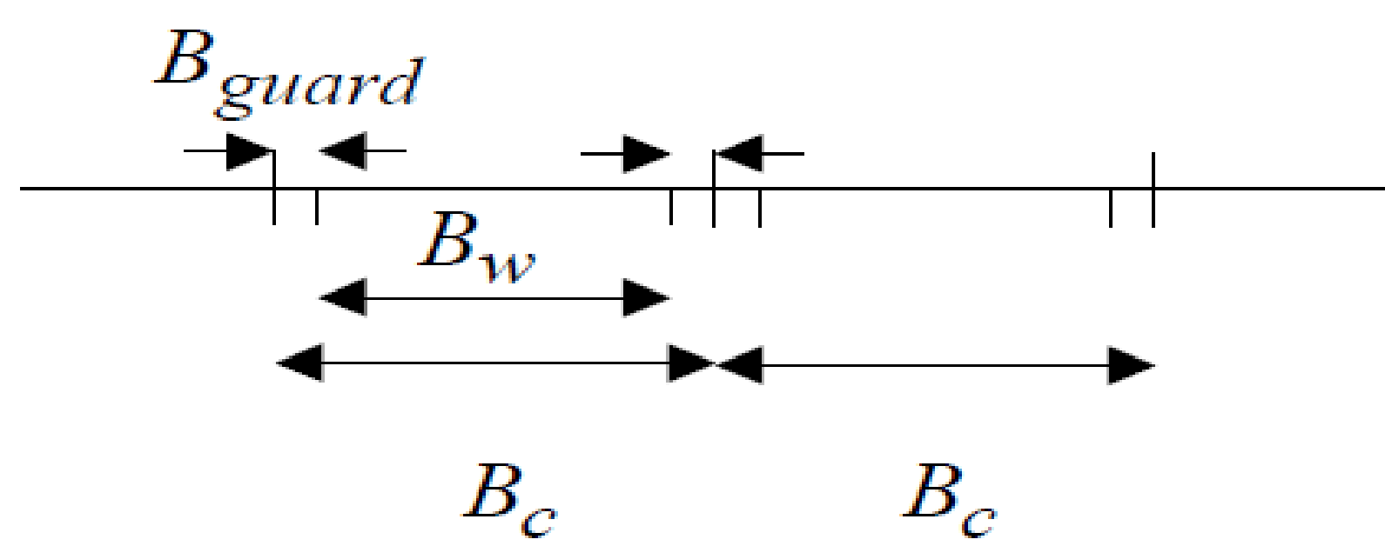
FDMA
Implemented in narrowband systems.
All channels in a cell are available to all the mobiles.
Channel assignment - first-come first- served basis.
Guard bands allow for imperfect filters and oscillators and can be used to minimize adjacent channel interference.

Slide 33
Features of FDMA
Carries only one phone circuit at a time-FDMA allots a different sub-band of frequency to each different user to access the network..
wasted resource: If FDMA channels are not in use, then it sits idle and cannot be used by other users to increase or shared capacity.
Continuous transmission : after the assignment of a voice channel BS and mobile transmit continuously and simultaneously.
Narrow bandwidth : Analog cellular systems use 25-30 kHz.
Low ISI : Symbol time is large compared to average delay spread. No equalizer is required

Slide 34
Features of FDMA
Low overhead : fewer bits need for overhead purpose (such as synchronization and framing bits) to be dedicated compared to TDMA channels.
higher cell site system costs :as compared to TDMA because of single channel per carrier design and need to use costly bandpass filters (to eliminate spurious radiation at BS)
Use of duplexer: since both the transmitter and receiver operate at the same time it increases cost of mobile and BSs.
Tight RF filtering: to minimize adjacent channel interference

Slide 35
Nonlinear effects in FDMA
Many channels share the same antenna at the BS.
The power amplifiers or the power combiners, when operated at or near saturation for maximum power efficiency, are nonlinear.
The nonlinearities cause signal spreading in frequency domain and generate inter-modulation(IM) frequencies.
IM: generation of undesirable RF harmonics
Harmonics generated outside the mobile radio band: cause interference to adjacent services.
Undesirable harmonics present inside the band: cause interference to other users in the wireless system.

Slide 36
The first US analog cellular system, the Advanced Mobile Phone System (AMPS), is based on FDMA/FDD.
A single user occupies a single channel while the call is in progress, and the single channel is actually two simplex channels which are frequency duplexed with a 45 MHz split.
When a call is completed, or when a handoff occurs, the channel is vacated so that another mobile subscriber may use it.
Multiple or simultaneous users are accommodated in AMPS by giving each user a unique channel.
Voice signals are sent on the forward channel from the base station to mobile unit, and on the reverse channel from the mobile unit to the base station.
In AMPS, analog narrowband frequency modulation (NBFM) is used to modulate the carrier.
The number of channels that can be simultaneously supported in a FDMA system is given by:

Slide 37
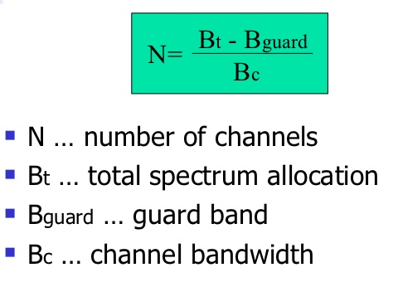
Number of channels in FDMA

Slide 38
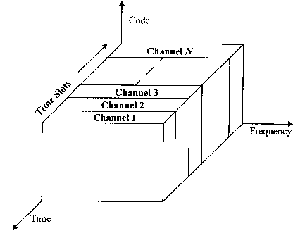
TDMA
TDMA systems divide the channel time into frames.
Each frame is further partitioned into time slots.
In each slot only one user is allowed to either transmit or receive.
Unlike FDMA, only digital data and digital modulation must be used.
Each user occupies a cyclically repeating time slot, so a channel may be thought of as a particular time slot of every frame.

Slide 39
Features of TDMA
Shares single carrier frequency with several users.
Burst transmission: data transmission is non continuous, but occurs in bursts.
Low Battery Consumption: Transmitter can be turned off during idle period (when not in use).
Narrow or wide bandwidth – depends on factors such as modulation scheme, number of voice channels per carrier channel.
Simpler Handoff: MAHO by listening to neighboring base station during the idle slot of the TDMA frame.

Slide 40
Features of TDMA
No Duplexers used: uses different time slots for transmission and reception.
Adaptive equalizer– Higher transmission symbol rate, hence resulting in high ISI
High synchronization overhead – as transmission are slotted, receivers to be synchronized for each data burst.
Guard slots: necessary to separate users. With minimum guard time.

Slide 41
TDMA FRAME
One TDMA Frame
Preamble
Information
Trail Bits
Slot 1
Slot 2
Slot 3
…
Slot N
Guard
Bits
Sync
Bits
Control
Bits
Information
CRC
One TDMA Slot
A Frame repeats in time
Preamble 🡪 Address and synchronization information for base station and subscriber identification

Slide 42





Frame efficiency parameters

Slide 43
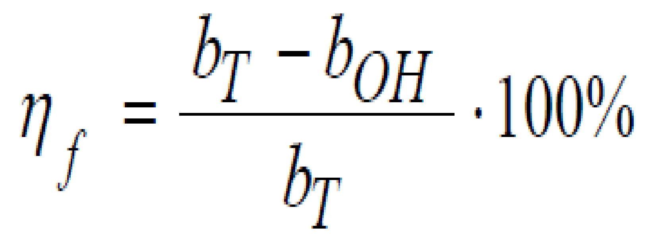
Efficiency of TDMA
A measure of the percentage of bits per frame which contain transmitted data.
The transmitted data include source and channel coding bits.
b_{OH} includes all overhead bits such as preamble, guard bits, etc.

Slide 44
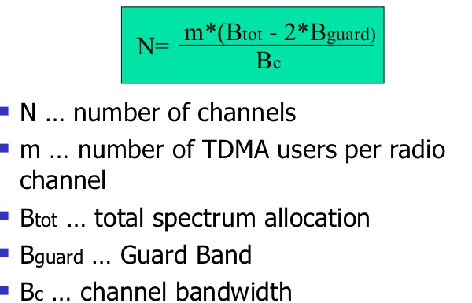
Number of Channels in TDMA

Slide 45
Multiple Access Techniques in Mobile communication System
Cellular System | Multiple Access Technique
AMPS | FDMA/FDD
GSM | TDMA/FDD
USDC (IS-54 and IS-136) | TDMA/FDD
PDC | TDMA/FDD
CT2 Cordless Phone | FDMA/TDD
DECT Cordless Phone | FDMA/TDD
US IS-95 | CDMA/FDD
W-CDMA | CDMA/FDD CDMA/TDD
cdma2000 | CDMA/FDD CDMA/TDD

Slide 46
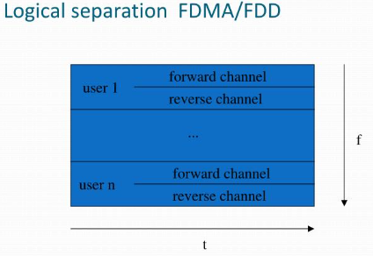
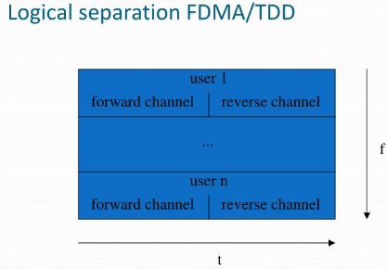
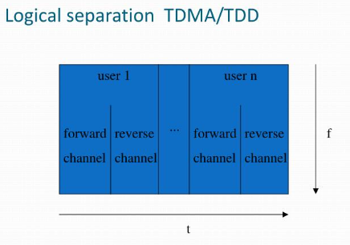
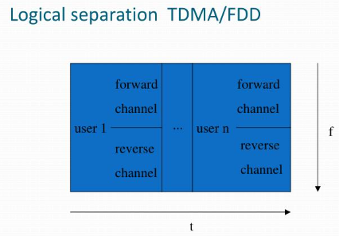

Slide 47
SELF Reflection
1.Name 2 narrow band and 2 wideband technologies.
2.Compare and Contrast FDMA and TDMA.

Slide 48
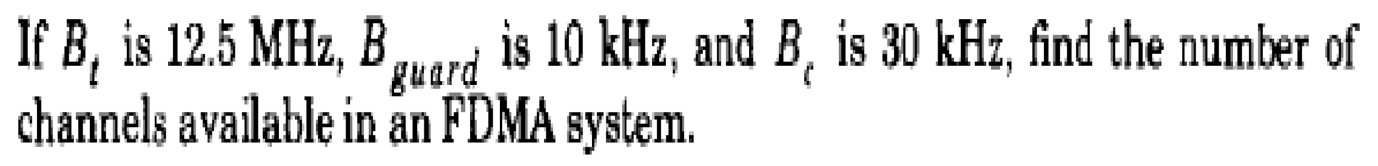
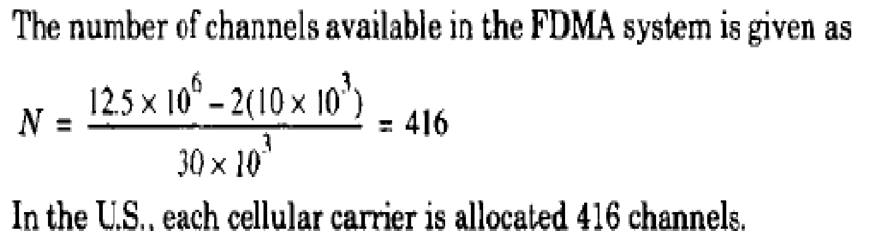
Example 1
Solution

Slide 49
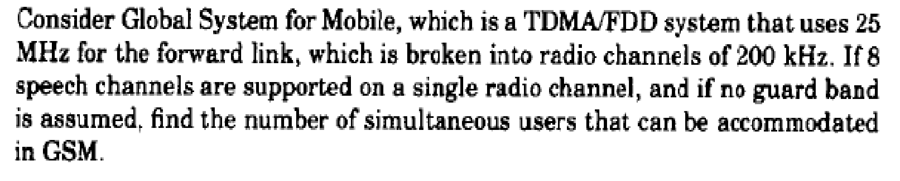
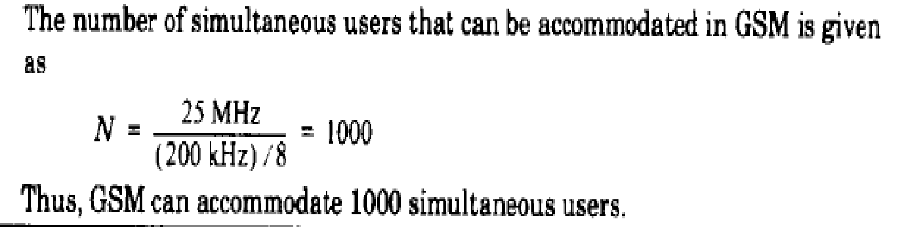
Example 2
Solution

Slide 50
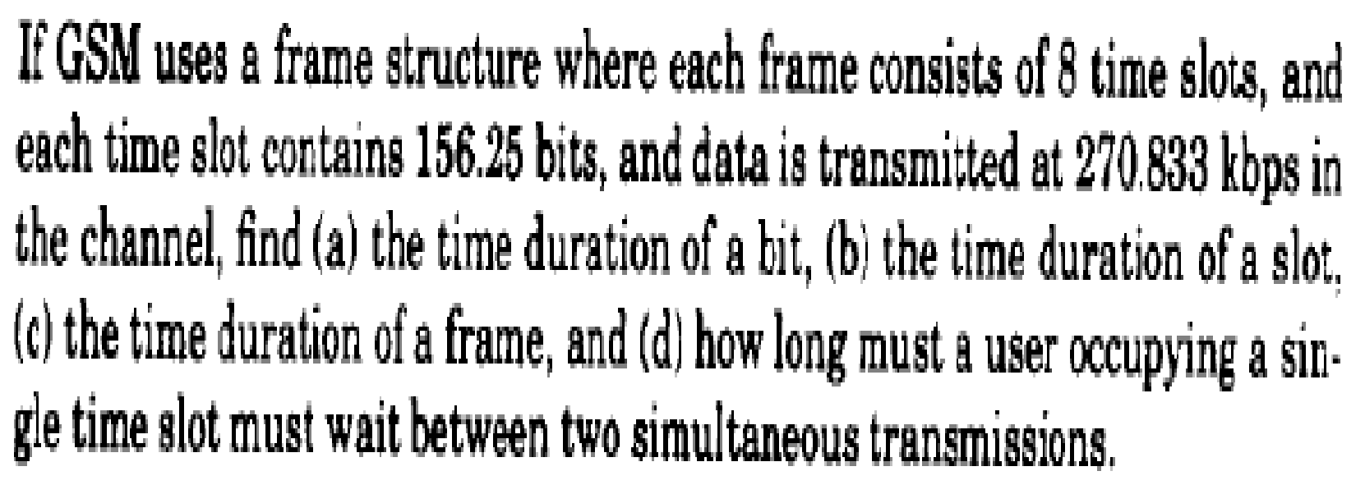
Example 3

Slide 51
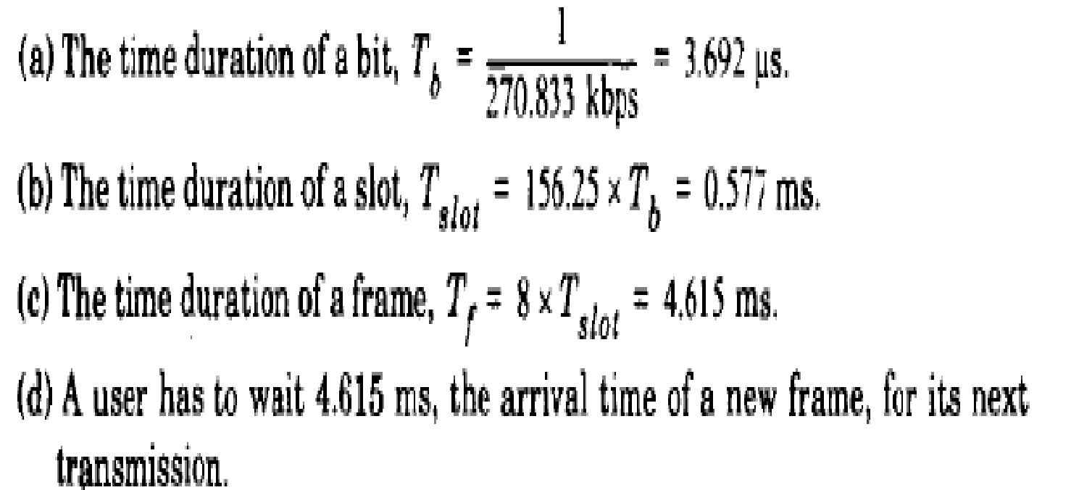
Solution

Slide 52
Example 4
A normal GSM has 3 start bits, 3 stop bits(also called as trailing bits), 26 training bits for allowing adaptive equalization, 8.25 guard bits and 2 bursts of 58 bits of encrypted data which is transmitted at 270.833 kbps in the channel.
Find
Number of overhead bits per frame, boh
Total number of bits/frame
Frame rate
Time duration of a slot
Frame efficiency

Slide 53
Solution
A time slot has 6+ 8.25+26+2(58) = 156.25bits
Number of overhead bits, boh = (8*6) + (8*8.25) + (8*26) = 322bits
Number of bits/frame = 8* 156.25 = 1250 bits/frame
Frame Rate= 270.833kbps/1250 bits/frame = 216.66 Frame/sec
d) Time duration of a slot = 156.25* (1/270.833kbps) = 576.92us
e) Frame efficiency = Ƞ = [1-(322/1250)] = 74.24%

Slide 54
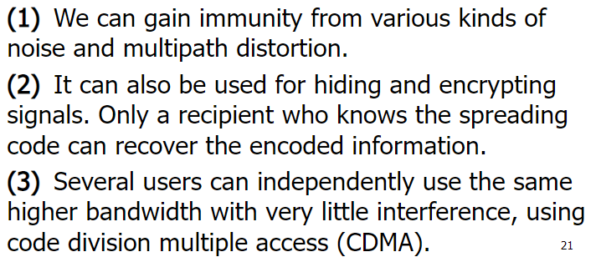
Benefits of spread spectrum

Slide 55
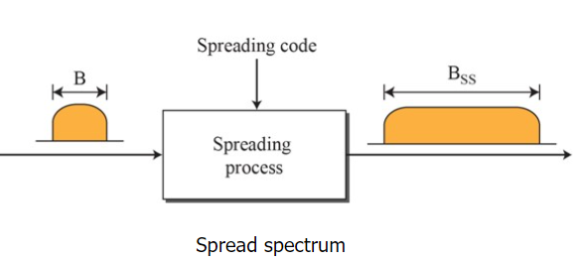
Spread Spectrum Multiple Access (SSMA)
SSMA uses signals which have a transmission BW that is several orders of magnitude greater than the minimum required RF BW.
A pseudo-noise (PN) sequence converts narrowband signal to a wideband noise like signals before transmission.
Application: developed for military applications for
Security
Undetectability: minimum probability of being detected
Robust against intentional jammers

Slide 56
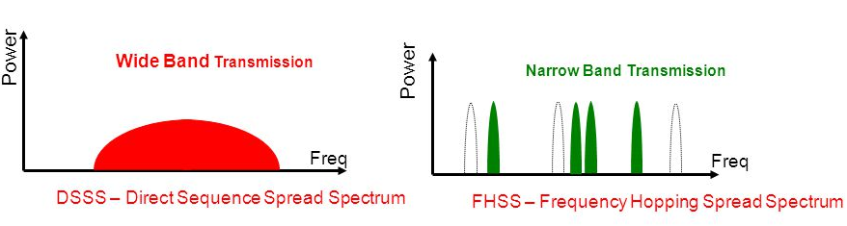
Spread Spectrum Multiple Access
Two techniques:
Frequency Hopped Multiple Access (FHMA)
Direct Sequence Multiple Access (DSMA) -Also called Code Division Multiple Access (CDMA)

Slide 57
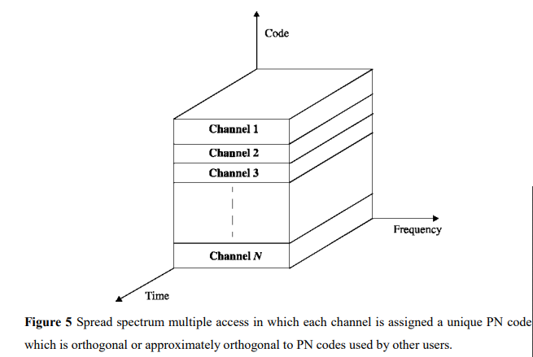
Frequency Hopped Multiple Access (FHMA)
Digital muliple access technique
It varies carrier frequency of individual users in a pseudo-random fashion within a wideband channel.
FHMA allows multiple users to simultaneously occupy the same spectrum at the same time, where each user dwells at a specific narrowband channel at a particular instance of time, based on the particular PN code of the user
Frequency hopping spread spectrum (FHSS) is a method of transmitting radio signals by shifting carriers across numerous channels with pseudorandom sequence which is already known to the sender and receiver.

Slide 58
The principle of FHSS:
A wide frequency band is divided into multiple channels and communications are jumping (hopping) sequentially from one channel to another in a sequence and a rate agreed to advance between the transmitter and the receiver.
The rate of hopping from one frequency to another is a function of the information rate.
The specific order in which frequencies are occupied is a function of a code sequence.
The set of possible carrier frequencies is called hop set.
Example where FHMA is adopted: GSM and Bluetooth

Slide 59
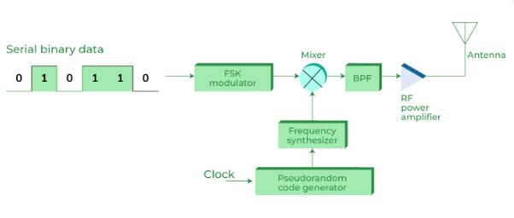
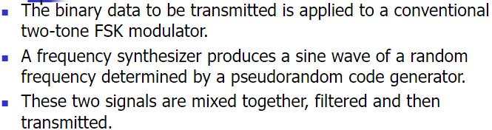

Slide 60
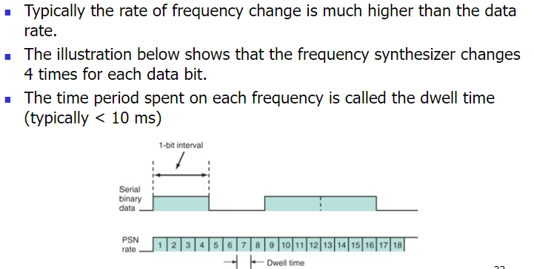

Slide 61
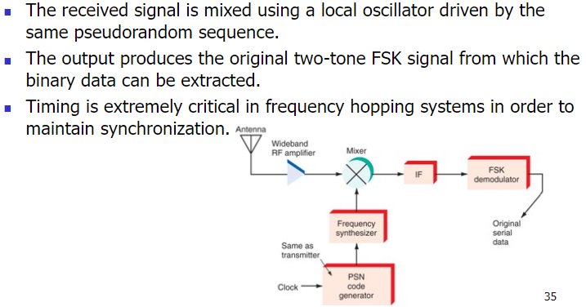

Slide 62
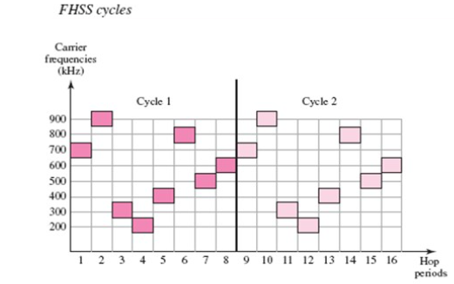

Slide 63
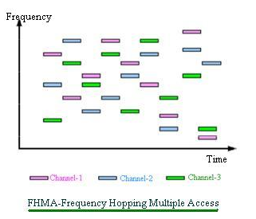

Slide 64
Dwell time
FHSS include three characteristics
Dwell time
Hoping sequences
Hop time
Dwell time– the amount of time spent on a specific frequency in FHSS hopping sequence is called as a dwell time.
Hopping sequences- The hopping sequence is a predetermined list of carrier frequencies that are used in a specific order during the transmission of a burst of information

Slide 65
The major difference between FDMA and FHMA is that FDMA uses constant RF frequency for transmission while FHMA uses range of frequencies as per hopping sequence.
This means FHMA does not use single constant frequency as used by FDMA for transmission.
GSM uses both FDMA and FHMA access techniques.

Slide 66
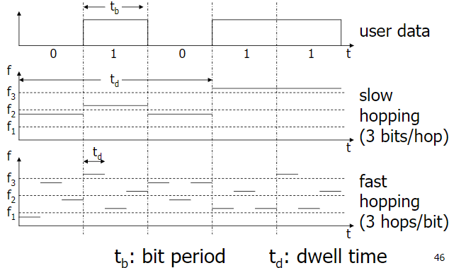
Relation between hopping rate and symbol rate
Slow Frequency Hopping- If symbol rate is greater than or equal to hopping rate. Multiple bits are transmitted in a hopping period.
Fast Frequency Hopping- If hopping rate is greather than symbol rate .One bit transmitted in multiple hops.

Slide 67
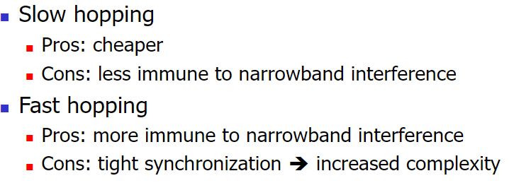

Slide 68
Benefits or advantages of FHSS
Following are the benefits or advantages of FHSS: ➨It provides very robust transmission path in the presence of interferences such as multipath, noise and other wireless transmissions etc. due to support of wide bandwidth. ➨It can be employed in point to multipoint applications. ➨It supports about ten nearby WLAN compliant APs (Access Points) without any significant interference issues. ➨It provides security against any kind of intrusion as only transmitter and receiver are aware of PN codes.
Drawbacks or disadvantages of FHSS
Following are the disadvantages of FHSS: ➨As FHSS relies on carrier frequencies to transmit information bits, it leads to strong bursty errors due to frequency selective fading mainly. ➨It supports lower data rate of 3 Mbps compare to 11 Mbps supported by DSSS. ➨It supports lower coverage range due to high SNR requirement at receiver. ➨The modulation scheme has become obsolete due to use of emerging wireless technologies in the wireless products.

Slide 69
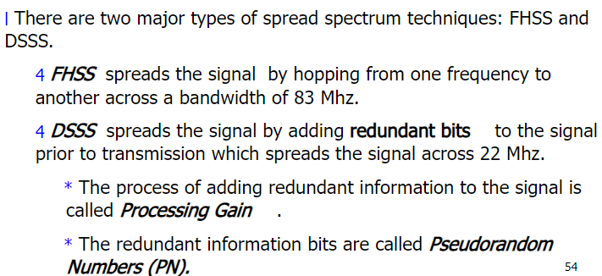
Direct Sequence Spread Spectrum – DSSS
The DSSS (Direct Sequence Spread Spectrum) is a technique spread spectrum, but unlike the FHSS, no frequency hopping is place
DSSS causes very rapid state transitions (chipping) which tend to spread the spectrum of the signal

Slide 70
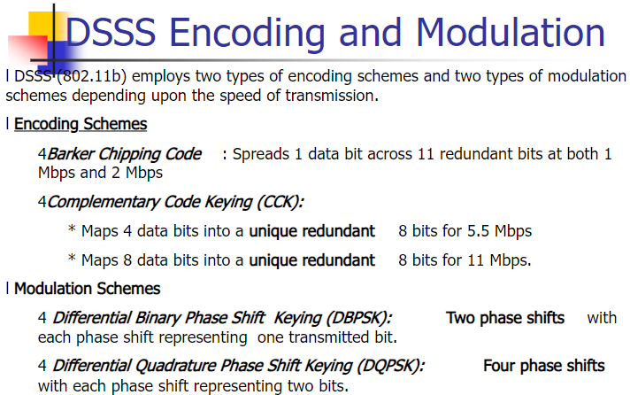

Slide 71
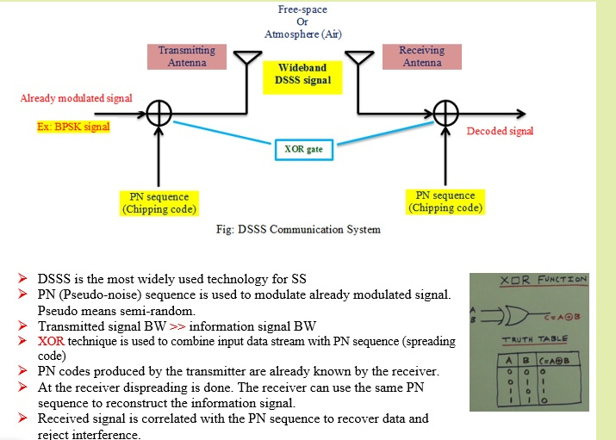

Slide 72
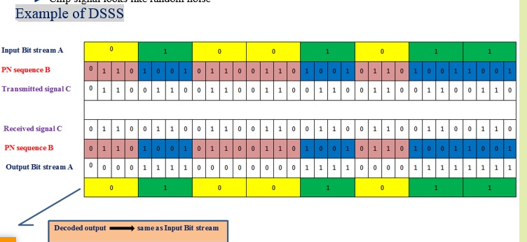

Slide 73
To do this, the transmitter sends a sequence of several bits, called chips, for each information bit to be transmitted.
For example, we may choose to send 11101 instead of 0 and its inverse (00010) instead of one:
in this case, if one wants to transmit information 010, then we will issue the following chips:
11101 00010 11101. In this example, the 11101 sequence is called the “spreading code”. Over this code, the longer the flow is artificially multiplied, so more spectrum is spread

Slide 74

Barker sequence

Slide 75


Slide 76


Slide 77

Complementary code keying

Slide 78
DSSS has two important interests:
• First, as we have said, the signal spectrum is spread, with all the advantages (and disadvantages) that this brings, especially better resistance to noise;
• in that it emits several chips for each bit of information means that can have a significant redundancy that corrects errors transmission.
For example, in the previous example, since the receiver knows the spreading code used (11101) then he knows he should receive than 11101 (for the information bit 0) or 00010 (for bit 1). If it receives 00110, it can easily correct the error in considering that the nearest is 00010 (corresponding to bit 1).
802.11 identified fourteen channels of 22 MHz wide, in the same strip of frequencies in the 2.4 GHz FHSS.
To communicate, the transmitter and receiver must agree on a fixed channel to use. A flow rate of 1 Mb / s, the 802.11 DSSS modulation based on 2DPSK we saw the 2 Mbit / s DSSS simply uses the 4DPSK modulation.
In both cases, the spreading code has a length of 11 bits and it is always equal to 10110111000. This code is part of a family of codes to mathematical properties Similar defined in 1953 by the mathematician Barker: they promote a good spread spectrum (as would not do, for example, the code 11111111111) and format makes them well suited to synchronize the transmitter and the receiver, which limits problems due to multipath.

Slide 79

Code Division Multiple Access (CDMA)
The basic principle is that different CDMA codes are used to distinguish among the different users.

Slide 80
Code Division Multiple Access (CDMA)
In CDMA, the narrowband message signal is multiplied by a very large bandwidth signal called spreading signal (code).
Spreading signal is a pseudo noise code sequence that has a chip rate which is orders of magnitude greater than the data rate of the message.
CDMA is also called Direct Sequence Spread Spectrum(DSSS). DSSS is a more general term.
Message consists of symbols ,symbol period and hence, symbol rate

Slide 81

Two ways in which CDMA is implemented, namely,
Direct Sequence/ Sequencing
Frequency Hopping
Direct sequence spread spectrum makes use of high-speed spreading code to have wider bandwidth
while in frequency hopping technique carrier frequency is shifted to obtain the same.

Slide 82


Slide 83


Slide 84


Slide 85


Slide 86


Slide 87


Slide 88


Slide 89


Slide 90


Slide 91

All users in a CDMA system, use the same carrier frequency and may transmit simultaneously.
Each user has its own pseudorandom code word which is approximately orthogonal to all other code words.
The receiver performs a time correlation operation to detect only the specific desired code word.
All other code words appear as noise due to de-correlation.
For detection of the message signal, the receiver needs to know the code word used by the transmitter.
Each user operates independently with no knowledge of the other users.

Slide 92
Code Division Multiple Access (CDMA) Features
Low power spectral density
Signal is spread over a larger frequency band
Other systems suffer less from the transmitter
Interference limited operation
All frequency spectrum is used
Privacy
The codeword is known only between the sender and receiver. Hence other users can not decode the messages that are in transit
Reduction of multipath affects by using a larger spectrum

Slide 93
Code Division Multiple Access (CDMA) Features
Random access possible
Users can start their transmission at any time
Cell capacity is not fixed like in TDMA or FDMA systems. has soft capacity.
Higher system capacity than TDMA and FDMA
No frequency management
No equalizers needed
No guard time needed
Enables soft handoff

Slide 94


Slide 95
Applications of CDMA
The high capacity and security offered by CDMA make it worthy for use in the field of wireless technology such as mobile telephony, radar, and navigation systems.
The combined use of CDMA with GSM technology has provided high-speed internet services like 4G.

Slide 96


Slide 97
OFDM –orthogonal frequency division multiplexing
Digital multi-carrier modulation scheme - extends the concept of single subcarrier modulation by using multiple subcarriers within the same single channel.
Rather than transmit a high-rate stream of data with a single subcarrier, OFDM makes use of a large number of closely spaced orthogonal subcarriers that are transmitted in parallel.
Each subcarrier is modulated with a conventional digital modulation scheme (such as QPSK, 16QAM, etc.) at low symbol rate.
However, the combination of many subcarriers enables data rates similar to conventional single-carrier modulation schemes within equivalent bandwidths.

Slide 98
OFDM is based on the well-known technique of Frequency Division Multiplexing (FDM).
In FDM different streams of information are mapped onto separate parallel frequency channels.
Each FDM channel is separated from the others by a frequency guard band to reduce interference between adjacent channels.
The OFDM scheme differs from traditional FDM in the following interrelated ways:
1. Multiple carriers (called subcarriers) carry the information stream,
2. The subcarriers are orthogonal to each other, and
3. A guard interval is added to each symbol to minimize the channel delay spread and intersymbol interference.

Slide 99
OFDM is a special case of FDM ( Frequency Division Multiplexing).
In FDM, the given bandwidth is subdivided among a set of carriers. There is no relationship between the carrier frequencies in FDM.
For example, consider that the given bandwidth has to be divided among 5 carriers (say a,b,c,d,e).
There is no relationship between the subcarriers ;a,b,c,d and e can anything within the given bandwidth.
If the carriers are harmonics, say (b=2a,c=3a,d=4a,d=5a , integral multiple of fundamental component a ) then they become orthogonal. This is a special case of FDM, which is called OFDM (as implied by the word – ‘orthogonal’ in OFDM)

Slide 100
SELF Reflection
1.Write a note on SSMA and its types.
2.What is Hybrid Multiple Access technique, explain its significance.
1) Compare 1G to 5G technologies.
2) Why will 5G require millions of small cells?
3) When will 5G go mainstream?
4) Will 5G work on 4G phones? Does your mobile support 5G? Did you buy new mobile to activate 5G services?
5) How will 5G change society?
6) How is 5G innovative?
7) Why 5G Networks Use Massive MIMO.
8) How will 5G enable a better future?
9) How beamforming beneficial in 5G?
https://www.youtube.com/watch?v=CkhA7s5GIGc
https://www.youtube.com/watch?v=CkhA7s5GIGc

Slide 101
Reference:
1. Wireless Communications principles and practice by T.S.Rappaport, Pearson Publication
2. https://youtu.be/AKXFwwcww_E
3. NPTEL video of IIT Kharagpur on Multiple Access technique.

Slide 102

Generations of wireless communication
We have made very huge improvements in wireless communication and have expanded the capabilities of our wireless communication system.
0th Generation:
Pre-cell phone mobile telephony technology, such as radio telephones some had in cars before the arrival of cell phones.
Communication was possible through voice only.
These mobile telephones were usually mounted in cars or trucks.

Slide 103
1G (1st Generation):
First-time calling was introduced in mobile systems.
It used an FDD scheme and typically allocated a bandwidth of 25 Mhz.
The coverage area was small.
No roaming support between various operators.
Low sound quality.
Speed:- 2.4 kbps.
Frequency 800 MHz and 900 MHz
Bandwidth: 10 MHz (666 duplex channels with bandwidth of 30 KHz)
Technology: Analogue switching
Modulation: Frequency Modulation (FM)
Mode of service: voice only
Access technique: Frequency Division Multiple Access (FDMA)
Reverse Channel : 824-849 MHz
Forward Channel : 869-894 MHz

Slide 104
Disadvantages of 1G system
Poor voice quality due to interference
Poor battery life
Large sized mobile phones (not convenient to carry)
Less security (calls could be decoded using an FM demodulator)
Limited number of users and cell coverage
Roaming was not possible between similar systems

Slide 105
2nd Generation
Second generation of mobile communication system introduced a new digital technology for wireless transmission also known as Global System for Mobile communication (GSM).
GSM technology became the base standard for further development in wireless standards later.
This standard was capable of supporting up to 14.4 to 64kbps (maximum) data rate which is sufficient for SMS and email services.
Code Division Multiple Access (CDMA) system developed by Qualcomm also introduced and implemented in the mid 1990s.
CDMA has more features than GSM in terms of spectral efficiency, number of users and data rate.

Slide 106
2G (2nd Generation) :
Shifted from analog to digital.
It supported voice and SMS both.
Supported all 4 sectors of the wireless industry namely Digital cellular, Mobile Data, PCS, WLAN.
Moderate mobile data service.
2G WLAN provided a high data rate & large area coverage.
Speed:- 64 kbps.
2.5G came after 2G which used the concept of GPRS.
Streaming was also introduced and mail services too.
Then came 2.75G or EDGE which was faster in providing services than 2.5G.
It gave faster internet speed up to 128kbps and also used edge connection.

Slide 107
Disadvantages of 2G system
Low data rate
Limited mobility
Less features on mobile devices
Limited number of users and hardware capability

Slide 108
2.5G and 2.75G system
In order to support higher data rate, General Packet Radio Service (GPRS) was introduced and successfully deployed.
GPRS was capable of data rate up to 171kbps (maximum). EDGE – Enhanced Data GSM Evolution also developed to improve data rate for GSM networks.
EDGE was capable to support up to 473.6kbps (maximum).
Another popular technology CDMA2000 was also introduced to support higher data rate for CDMA networks.
This technology has the ability to provide up to 384 kbps data rate (maximum).

Slide 109
3G – Third generation communication system
Third generation mobile communication started with the introduction of UMTS – Universal Mobile Terrestrial / Telecommunication Systems.
UMTS has the data rate of 384kbps and it support video calling for the first time on mobile devices.
After the introduction of 3G mobile communication system, smart phones became popular across the globe.
Specific applications were developed for smartphones which handles multimedia chat, email, video calling, games, social media and healthcare.

Slide 110
3G (3rd Generation) :
The Internet system was improved.
Better system and capacity.
Offers high-speed wireless internet.
The connection used was UMTS and WCMA.
Speed:- 2Mbps.
Higher data rate
Video calling
Enhanced security, more number of users and coverage
Mobile app support
Multimedia message support
Location tracking and maps
Better web browsing
TV streaming
High quality 3D games

Slide 111
3.5G to 3.75 Systems
In order to enhance data rate in existing 3G networks, another two technology improvements are introduced to network.
HSDPA – High Speed Downlink Packet access and
HSUPA – High Speed Uplink Packet Access, developed and deployed to the 3G networks.
3.5G network can support up to 2Mbps data rate.
3.75 system is an improved version of 3G network with HSPA+ High Speed Packet Access plus. Later this system will evolve into more powerful 3.9G system known as LTE (Long Term Evolution).
Disadvantages of 3G systems
Expensive spectrum licenses
Costly infrastructure, equipment and implementation
Higher bandwidth requirements to support higher data rate
Costly mobile devices
Compatibility with older generation 2G system and frequency bands

Slide 112
4G – Fourth generation communication system
4G systems are enhanced version of 3G networks developed by IEEE, offers higher data rate and capable to handle more advanced multimedia services.
LTE and LTE advanced wireless technology used in 4th generation systems.
Furthermore, it has compatibility with previous version thus easier deployment and upgrade of LTE and LTE advanced networks are possible.
Simultaneous transmission of voice and data is possible with LTE system which significantly improve data rate.
All services including voice services can be transmitted over IP packets.
Complex modulation schemes and carrier aggregation is used to multiply uplink / downlink capacity.

Slide 113
4G (4th Generation) :
IP-based protocols.
LTE (Long term evaluation) was mainly for the internet.
Vo-LTE (Voice over LTE) is for both voice and the internet.
Freedom and flexibility to select any desired service with reasonable QoS.
High usability.
Supports multimedia service at a low transmission cost.
HD Quality Streaming.
Speed:-100Mbps

Slide 114
Disadvantages of 4G system
Expensive hardware and infrastructure
Costly spectrum (most countries, frequency bands are too expensive)
High end mobile devices compatible with 4G technology required, which is costly
Wide deployment and upgrade is time consuming

Slide 115
5G – Fifth generation communication system
5G network is using advanced technologies to deliver ultra fast internet and multimedia experience for customers.
Existing LTE advanced networks will transform into supercharged 5G networks in future.
In earlier deployments, 5G network will function in non-standalone mode and standalone mode.
In non-standalone mode both LTE spectrum and 5G-NR spectrum will be used together.
Control signaling will be connected to LTE core network in non standalone mode.
In order to achieve higher data rate, 5G technology will use millimeter waves and unlicensed spectrum for data transmission.
Complex modulation technique has been developed to support massive data rate for Internet of Things.

Slide 116
Key features of 5G technology
Ultra fast mobile internet up to 10Gbps
Low latency in milliseconds (significant for mission critical applications)
Total cost deduction for data
Higher security and reliable network
Uses technologies like small cells, beam forming to improve efficiency
Forward compatibility network offers further enhancements in future
Cloud based infrastructure offers power efficiency, easy maintenance and upgrade of hardware

Slide 117


Slide 118


Slide 119
What is 5G Wireless Technology and How it Works?
According to Robert J. Topol, Intel’s General Manager for 5G Business and Technology,
5G will be the post-smartphone era. But phones are the first place to launch because they’re such an anchor in our lives from a connectivity standpoint.

Slide 120
Introduction to 5G Wireless Technology
5G Wireless Technology is the 5th generation of mobile networks and an evolution from the current 4G LTE networks.
It is specially designed to fulfill the demands of current technological trends, which includes
a large growth in data and
almost global connectivity along
with the increasing interest in the Internet of Things.
In its initial stages, 5G Technology will work in conjugation with the existing 4G Technology and then move on as a fully independent entity in subsequent releases.
Now let’s try to answer some of the major questions associated with 5G Wireless Technology so that we can understand it better.

Slide 121
What is 5G Wireless Technology?
5G Wireless Technology is now the latest cellular technology that will greatly increase the speed of wireless networks among other things(And who doesn’t want that?!!).
So the data speed for wireless broadband connections using 5G would be at a maximum of around 20 Gbps.
Contrasting that with the peak speed of 4G which is 60 Mbps, that’s a lot! Moreover,
5G will also provide more bandwidth and advanced antenna technology which will result in much more data transmitted over wireless systems.

Slide 122
It will also provide various network management features such as Network Slicing using which mobile operators will be able to create multiple virtual networks using a single physical 5G network.
So in this futuristic scenario, if you are inside a self-driving car, then a virtual network with an extremely fast, low-latency connections would be required because obviously the car needs to navigate in real-time.
On the other hand, if you are using any smart appliance in your home, then a virtual network with lower power and a slower connection would be fine because it’s not a life or death situation!!!

Slide 123

How does 5G Wireless Technology Work?
There are basically 2 main components in the 5G Wireless Technology systems i.e.
The Radio Access Network and the Core Network

Slide 124
Radio Access Network:
Includes
5G Small Cells and
Macro Cells that form the crux of 5G Wireless Technology
The systems that connect the mobile devices to the Core Network.
The 5G Small Cells are located in big clusters because the millimeter wave spectrum (that 5G uses for insanely high speeds!) can only travel over short distances.
These Small Cells complement the Macro Cells that are used to provide more wide-area coverage.
Macro Cells use MIMO (Multiple Inputs, Multiple Outputs) antennas which have multiple connections to send and receive large amounts of data simultaneously.
This means that more users can connect to the network simultaneously.

Slide 125
2. Core Network:
The Core Network manages all the data and internet connections for the 5G Wireless Technology.
And a big advantage of the 5G Core Network is that it can integrate with the internet much more efficiently and it also provides additional services like cloud-based services, distributed servers that improve response times, etc.
Another advanced feature of the Core Network is network slicing (Which we talked about earlier!!!).

Slide 126
What are the Benefits of 5G Wireless Technology?
5G Wireless Technology will not only enhance current mobile broadband services, but it will also expand the world of mobile networks to include many new devices and services in multiple industries from retail to education to entertainment with much higher performances and lower costs.
It could even be said that 5G Technology as much as the emergence of automobiles or electricity ever did!!!
Some of the benefits of 5G in various domains are given here:
5G will make our smartphones much smarter with faster and more uniform data rates, lower latency and cost-per-bit and this, in turn, will lead to the common acceptance of new immersive technologies like Virtual Reality or Augmented Reality.

Slide 127
5G will have the convenience of ultra-reliable, low latency links that will empower industries to invest in more projects which require remote control of critical infrastructure in various fields like medicine, aviation, etc.
5G will lead to an Internet of Things revolution as it has the ability to scale up or down in features like data rates, power, and mobility which is perfect for an application like connecting multiple embedded sensors in almost all devices!
Three elements are key in 5G use cases
The rollout of 5G will provide benefits in three major areas, also known as the “5G triangle”:
uRLLC: Ultra Reliable Low Latency Communication use cases.
mMTC: Massive Machine Type Communication (IoT) use cases.
eMBB: Enhanced Mobile Broadband – high speed use cases

Slide 128

What are the Parameters for 5G Wireless Technology
Details about the performance of 5G Wireless Technology according to various parameters are given here:

Slide 129

5G technology is driven by 8 specification requirements:

Slide 130
What makes 5G faster?
According to communication principles, the shorter the frequency, the larger the bandwidth.
Using shorter frequencies (millimeter waves between 30GHz and 300GHz) for 5G networks is why 5G can be faster. This high-band 5G spectrum provides the expected boost in speed and capacity, low latency, and quality.
However,5G download speed may differ widely by area.
According to the February 2020 issue of Fortune Magazine, average 5G speed measures done in Q3/Q4 2019 range from:
220 megabytes per second (Mbps) in Las Vegas,
350 in New York,
380 in Los Angeles,
450 in Dallas,
to 550 Chicago,
and over 950 in Minneapolis and Providence approximatively.
That's 10 to 50 times more than 4G LTE.

Slide 131
5G low Latency
5G technology offers an extremely low latency rate, the delay between the sending and receiving information.
From 200 milliseconds for 4G, we go down to 1 millisecond(1ms) with 5G.
For example, low latency provides real-time interactivity for services using the cloud: this is key to the success of self-driving cars, for example.
5G vs 4G also means at least x100 devices connected. 5G must support 1 million devices for 0.386 square miles or 1 km².
Also, low power consumption is what will allow connected objects to operate for months or years without the need for human assistance.

Slide 132

5G Use cases
Healthcare.
Education.
Entertainment.
Industrial Internet of Things (IoT)
Autonomous Vehicles.
Smart Cities.

Slide 133
Below are some specific use cases for 5G, with each industry uniquely benefiting from 5G’s improved speed, capacity, and coverage.
While not every business needs 5G, almost all large environments that demand high uptime, consistent performance, and total visibility will benefit from private 5G.
Industrial IoT (IIoT)
Manufacturing companies were one of the first businesses to start implementing private cellular networks in their environment and reaping benefits.
Factories and industrial processes cannot afford downtime; replacing machines is often costly and out of the question.
Instead, manufacturers leverage IoT sensors to help gain new insights on old machines and send alerts to maintenance when problems might be on the horizon.
IIoT sensors require continuous wireless access often over thousands of square feet.
Private 5G networks enable factories to build the exact network they need to support IIoT sensors and other technology.

Slide 134
By strategically planning a cellular network, businesses can ensure their plants are free of dead zones and that service levels are being met.
Private 5G rises to industrial challenges by having the increased capacity and low-latency requirements to reliably support thousands of IIoT sensors and robotic machines in complex environments.
Some key industrial 5G use cases are the following:
Preventive maintenance through IoT sensors
Productivity and performance monitoring
Providing internet connectivity to legacy machines without replacement
Controlling robotics remotely with no noticeable delay or interference

Slide 135
Healthcare
Healthcare networks are often complicated, encompassing multiple medical machines, patient sensors, healthcare applications, and monitoring devices that span thousands of square feet.
Devices must remain secure but accessible.
Patient data must remain confidential but available to the right staff.
Hospitals use IoT sensors to track the performance and location of critical hardware such as insulin pumps, ventilators, crash carts, and EKG machines.
These sensors can help maintenance know where equipment is and when it needs to be repaired.
Managers can also use this data to understand their capacity and inventory levels for equipment and even medication.

Slide 136
Since cellular devices use secure SIM authentication, cellular networks prove to be a much more secure option than other wireless alternatives, making it easier to stay compliant.
Even in the busiest hours, hospital IT staff can rest easy knowing their 5G network can reliably support a growing number of patients, visitors, and device inventory.
Some key healthcare 5G use cases are the following:
Inventory management of machines, drugs, supplies, and medical waste
Physical location tracking of life-saving equipment
Preventive maintenance sensors that automatically create work orders
Secure cross-campus service for both staff and patients

Slide 137
Autonomous Vehicles
Autonomous vehicles need to be able to process information and adjust accordingly in as little time as possible.
The ultra-low latency, increased capacity, and coverage will enable fleets of autonomous vehicles to receive updates and make changes.
While driverless vehicles aren’t everywhere yet, 5G will play a critical role in how vehicles communicate and function at scale.
Weather stations can share insights with autonomous drones in the air, allowing them to adjust their course automatically with no human input.
Other vehicles may be able to share insights with each other to help avoid accidents, reduce highway congestion, and improve safety standards.

Slide 138
Vehicle manufacturers will be able to update firmware, patch security flaws, and add new features leveraging 5G networks.
As this technology evolves new opportunities will emerge for companies to serve the autonomous vehicle market by using private 5G as the backbone of their business.
Some key autonomous vehicle 5G use cases are the following:
Automatic updates, security patches, and feature additions
Real-time weather, traffic, and safety updates to vehicles in route
Safe retrieval of stolen vehicles
Vehicle-to-vehicle communication
Waymo, Tesla, and Uber are all working towards making self-driving cars a reality, so the future of autonomous cars is right around the corner

Slide 139
Education
Both college campuses and KG–12 schools can leverage private 5G to provide campus-wide network access and bridge the digital divide.
College campuses have the challenging task of providing secure network access for students and staff across the size of a small town.
This can be a challenge especially with multiple buildings and outdoor study areas that need wireless access.
The power levels cellular networks offer make it easy to provide blanket coverage over many acres of both indoor and outdoor space.
Through a combination of indoor and outdoor infrastructure, college campuses can ensure lecture halls, study areas, and outdoor spaces are adequately covered.

Slide 140
Long-range roof-mounted antennas can extend well beyond the campus ground and allow students to access school resources from their homes, even if they don’t have internet at home.
Since each device uses SIM technology, IT staff can easily manage devices and segment staff and student networks with ease.
Some key education 5G use cases are the following:
Providing controlled internet access for students at home
Designing reliable cellular blanket coverage across campus
Using IoT sensors to track classroom attendance, study room availability, and public transportation
Securely segment staff and students networks
Promote fast and reliable outdoor learning

Slide 141
Smart Cities
Smart cities may seem like a concept from the future, but they are already here.
City governments use 5G networks to provide better services to their citizens, track public utilities, and monitor city infrastructure proactively.
In some cases, municipalities offer portions of the 5G network for their citizens to use as a free service.
Services such as waste management and water treatment can use 5G networks to track their fleet and monitor critical infrastructure for issues.
IoT-enabled dumpsters and trucks can monitor fleet inventory and help cities understand how much waste they produce and where that waste accumulates.

Slide 142
Transportation departments can use 5G to monitor for highway congestion and reliably access high-definition, live video feed of traffic cameras across the city.
With the ability to span hundreds of miles and support millions of devices, 5G networks make smart cities a reality.
A few smart city 5G use cases are the following:
Fleet tracking
Infrastructure monitoring with IoT sensors
City-wide video surveillance and traffic cameras
Secure and controlled internet access for residents
The Alba Iulia Smart City, which successfully included bottleneck management, parking sensors, and automated wastewater treatment, is one of the 5G use cases being showcased by network providers.

Slide 143
Transportation
Whether you’re moving people or products, the scale of 5G provides more timely and accurate insights into where things are going and when they’ll arrive.
In shipping, massive warehouses need to stay connected in order to provide updates to managers.
IoT sensors on pallets and shipping containers can share their arrival and departure from facilities automatically.
On the back-end, managers can use that data to track performance against their baseline and even more accurately predict future arrival times of new shipments.
Similarly, fleet tracking provides insights for both public and private transportation. Organizations can use real-time metrics to understand their efficiency, utilization, and best routes based on the latest data.

Slide 144
A few key transportation 5G use cases are the following:
Fleet tracking
Automatic time-stamping of shipped and received products
Dynamic insights based on live data
Highly accurate inventory management and capacity planning

Slide 145
Entertainment
Outdoor venues, stadiums, and theme parks all face a considerable challenge when it comes to providing reliable network access.
These environments tend to be both indoors and outdoors, cover large swaths of land, and have a high number of devices they need to support.
The power level 5G operates at allows organizations to cover large areas with significantly less hardware than other wireless technology.
By using multiple frequency bands and a range of different hardware, entertainment companies can ensure reliability and speed both inside and outdoors.
Small and medium cell towers positioned throughout the park can provide blanket coverage for both guests and staff members.
Since 5G has such a large capacity for devices, the network won’t grind to a halt when the park is full or the stadium is packed.

Slide 146
A few key entertainment 5G use cases are the following:
Proactive maintenance via IoT sensors
Secure and reliable guest access through neutral host services
Ensuring both indoor and outdoor areas have high-speed network access
Providing reliable service to a large unpredictable number of devices

Slide 147
MIMO
What is MIMO
An antenna technology that improves the radio link by using the multiple paths over which signals travel from the transmitter to the receiver, primarily as a result of the many reflections that the signal undergoes and the many paths over which it can travel.
The multiple paths are de-correlated and this provides the opportunity to send multiple data streams over them.
For example, MIMO may have a two transmit and two receiver (2T2R) format; this is low-capacity 2×2 MIMO. medium capacity 4×4 MIMO that is a 4T4R version.
Massive MIMO is an extension of MIMO and provides advanced antenna technology with multiple antennas on base stations, to serve multiple end-user devices simultaneously within one time interval.

Slide 148
This advanced antenna technology enhances spectral efficiency, network capacity, and coverage with easily achievable data rates;
MIMO is one of the key enabling techniques for 5G wireless technology, providing increases in throughput and signal to noise ratio.
It is used in Wi-Fi 802.11 and is a central part of 4G LTE as well as many other radio communications technologies.
Using MIMO antennas and beam-forming techniques, 5G wireless technology is able to offer increased capacity and data speed.

Slide 149

Figure 1

Slide 150

Massive MIMO is also called FD (full-dimensional) MIMO.
Generally, an antenna array with more than 16 antennas is considered a Massive MIMO.
Compared with traditional MIMO, Massive MIMO introduces beamforming technologies.
Massive MIMO is essentially an antenna technology and is decoupled from air interface technologies.

Slide 151

In general, beamforming is a particular processing technique for signals that allow for directional transmission or reception. 5G beamforming allows Verizon to make 5G connections more focused toward a receiving device.
For example, a typical 5G small cell that does not employ beamforming during its multiple-input multiple-output (MIMO) transmission will not be able to narrowly concentrate or focus its transmit beams to a particular area.
With beamforming, the small cell can focus the transmission in a particular direction towards a mobile device such as a cell phone, laptop, autonomous car or IoT node. This improves the efficiency overall of the network and saves energy.

Slide 152

Antenna layers in 5G massive MIMO are quite a bit higher than the MIMO in 4G LTE. Massive MIMO deploys tens or even hundreds of antenna elements within a single antenna panel.
For example, a 64×64 massive MIMO high-capacity antenna configuration has already been deployed by some 5G network vendors, and 256×256 arrays are also possible.
Figure 2. An 8×8 massive MIMO antenna. Image: Taoglas

Slide 153
Network Requirements of Massive MIMO
1. Frequency Band Requirements
The number of antenna elements in Massive MIMO is far greater than that of traditional antennas. Therefore, the distance between antenna elements should not be too large. Otherwise, the antenna size is too large and cannot meet the installation requirements.
The distance between arrays is related to the frequency band.
The higher the frequency band, the smaller the spacing between arrays, which facilitates the deployment of Massive MIMO. (Currently, this model applies only to the frequency band above 2.6 GHz.)

Slide 154
2.Requirements for the duplex mode
The beamforming technology is introduced in Massive MIMO. The reciprocity of uplink and downlink channels in the TDD system facilitates the calculation of downlink beamforming weights. Therefore, the TDD system is more suitable for deploying Massive MIMO.
A new reference signal (CSI-RS) is introduced to calculate the downlink weight of an FDD system, but the performance is slightly worse than that of a TDD system.

Slide 155
Benefits Of Massive MIMO – Why 5G Networks Use Massive MIMO
Massive MIMO efficiently utilizes the radio network resources to improve network capacity leading to a higher throughput and multi-user support.
It uses the beamforming technique to focus the transmission power in specific directions which extends the network coverage whilst minimizing interference.
Massive MIMO is one of the key enablers for the New Radio (NR) technology used in 5G networks.
It improves the radio network capacity as well as the network coverage.
The benefits of Massive MIMO include spectral efficiency, higher throughput, lower interference and extended range.

Slide 156
Spectral Efficiency
Massive MIMO employs spatial multiplexing, which efficiently uses frequency and time resources to improve network capacity and, therefore, bit rates.
The different signal paths created by multiple antennas in Massive MIMO are used as sub-channels for sending and receiving data streams for multiple users
.
Higher Throughput
The use of multiple data streams through spatial multiplexing allows a user device to get higher overall bit rates.
In addition, due to the large number of antenna elements in Massive MIMO, a lot of additional capacity is created, enabling higher throughput for multiple users simultaneously.

Slide 157
Lower Interference
The beamforming technique provides targeted transmission of the radio signal, which makes the signal more robust in a specific direction.
That way, the main beam in the desired direction becomes the strongest, and the side beams (side lobes) become weaker, which minimizes any potential interference between the beams.
Extended Range
Massive MIMO has three-dimensional beamforming (3D beamforming), which creates horizontal and vertical beams of the signal so that it can reach people in different ranges (distance) and heights (e.g. high-rise buildings).
The beamforming technology also extends the network coverage by channeling the transmission power in a targeted direction to improve the range.

Slide 158
SELF Reflection, week 2
5) How will 5G change society?
6) How is 5G innovative?
7) Why 5G Networks Use Massive MIMO.
8) How will 5G enable a better future?
9) How beamforming beneficial in 5G?
1) Compare 1G to 5G technologies.
2) Why will 5G require millions of small cells?
3) When will 5G go mainstream?
4) Will 5G work on 4G phones? Does your mobile support 5G? Did you buy new mobile to activate 5G services?
.

